Slide 1

SPRING FRAMEWORK
ABIRAMASUNDHARI SINGARAVELAN
JAVA FSE TRAINER
COGNIZANT
AS

Slide 2
SPRING FRAMEWORK
Spring Framework
Inversion of Control
Dependency Injection
AutoWiring
Properties
Stereotype Annotation
AS

Slide 3


Spring is a great framework for development of Enterprise grade applications.
IT is a light weight framework for the development of
enterprise-ready applications.
It provides very simple and rich facilities to integrate various frameworks,, technologies and services
in the applications.
AS

Slide 4

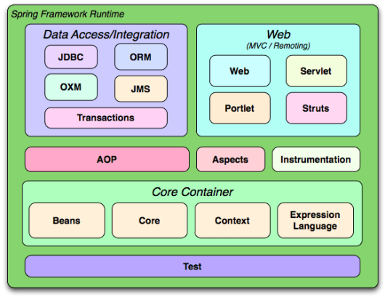
SPRING ARCHITECTURE
AS

Slide 5
INVERSION OF CONTROL
Responsible for instantiating, configuring, and assemble objects.
It gets information from xml file and works accordingly.
Tasks:
Instantiate the application class
Configure Object
Assemble dependencies between objects
Implementation Methods:
Application Context
BeanFactory
AS

Slide 6
INVERSION OF CONTROL
Interface responsible for providing configuration
information to an application.
ApplicationContext ac=new
ClassPathXmlApplicationContext (“Beans.xml”)
Name of Bean Configuration File
Standard Spring framework class for load bean
configuration file
AS

Slide 7
INVERSION OF CONTROL
reads the configuration metadata from an XML file
and uses it to create a fully configured system or
application.
XmlBeanFactory factory1=new XmlBeanFactory(new ClassPathResource ("Beans.xml"));
Name of Bean Configuration File
Standard Spring framework class for load bean
configuration file
Note: This XmlBeanFactory is deprecated in spring versions 5 and above. Hence you can use ApplicationContext interface to provide configuration
AS

Slide 8
Dependency Injection
Helps to remove any dependency in the code.
Retrieve a resource after demand.
Multiple ways:
Setter Injection
Constructor Injection
Injection on dependent objects
Injecting Collections
Injecting Interfaces
AS

Slide 9
Setter Injection
Class Student
{
private int id;
private String sname;
public String getId() {
return id;
}
public void setId(int id) {
this.id= id;
}
}
<bean id="employee“
class="com.cognizant.Student“>
<property name="id">
<value>001</value>
</property>
<property name=“sname">
<value>Arthi</value>
</property></bean>
Name of the bean
Package in which the class Student is defined.
Injection will happen by means of setter method

Slide 10
Setter Injection
Class Student
{
private int id;
private String sname;
public Student(int id,
String sname)
{
this.id=id;
this.sname=sname;
}
}
Name of the bean
<bean id="student"
class="com.cognizant.Student">
<constructor-arg value="10“ type="int"> </constructor-arg>
<constructor-arg value="Arthi" >
</constructor-arg>
</bean>
Package in which the
class Student is
defined.
Injection will happen by means constructor
AS

Slide 11
AutoWiring
The Spring container can autowire relationships between collaborating beans without using <constructor-arg> and <property> elements, which helps cut down on the amount of XML configuration you write for a big Spring-based application.
Four ways:
no
byName
byType
byConstructor
AS

